Slide 1
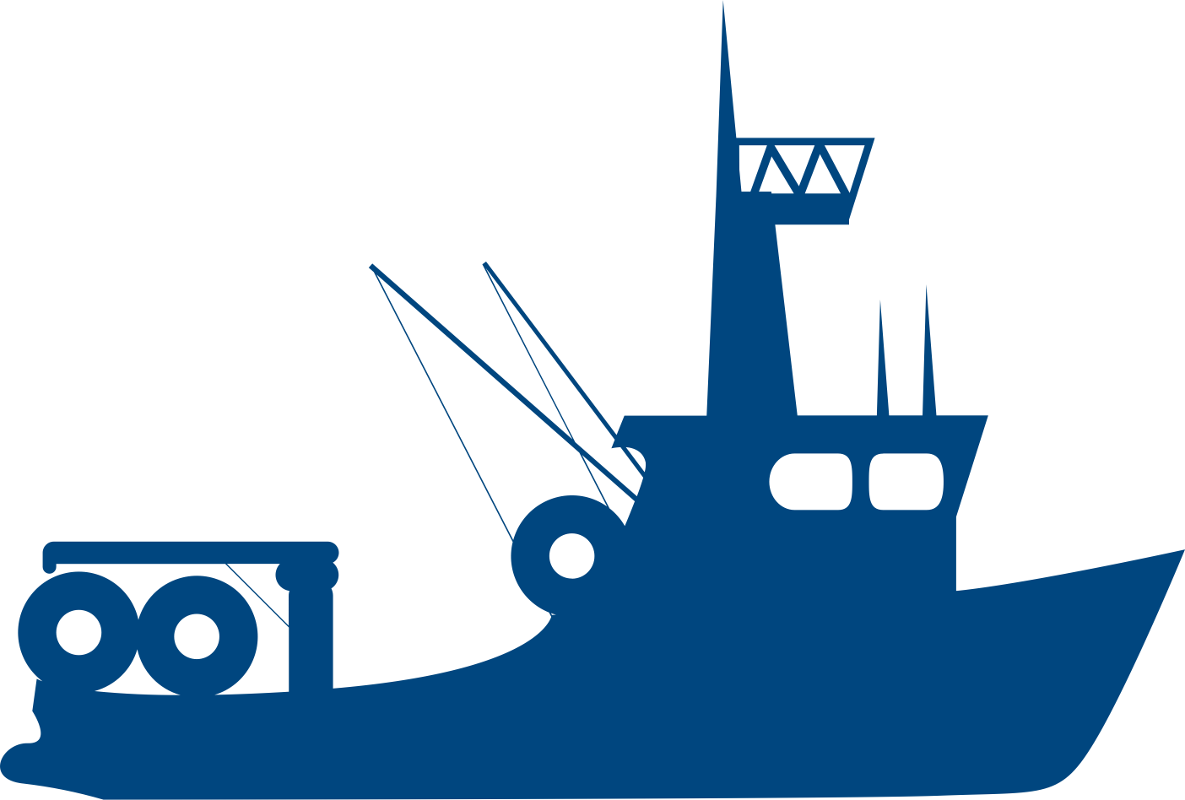

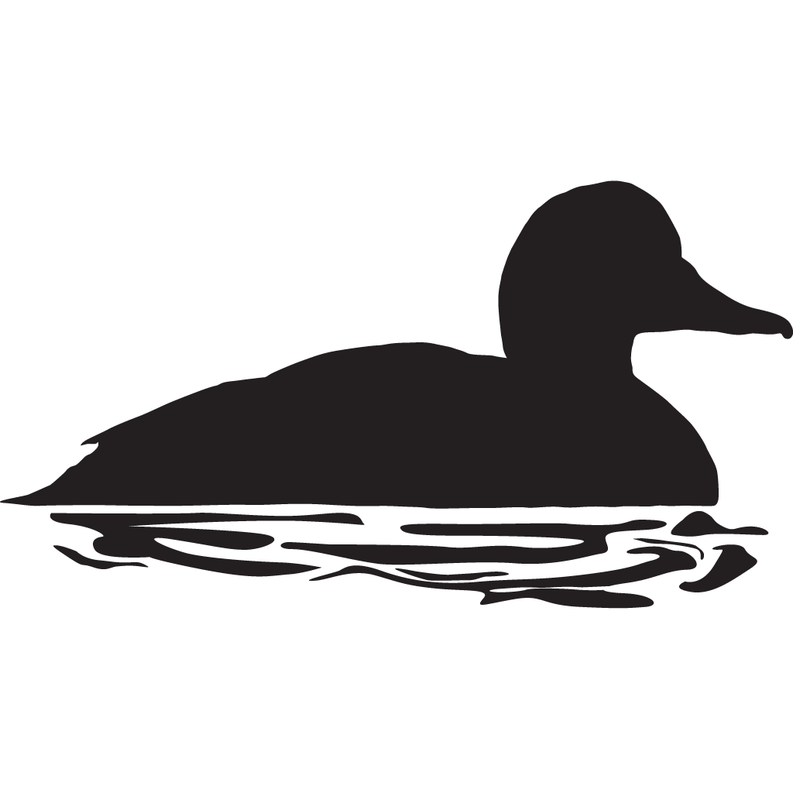
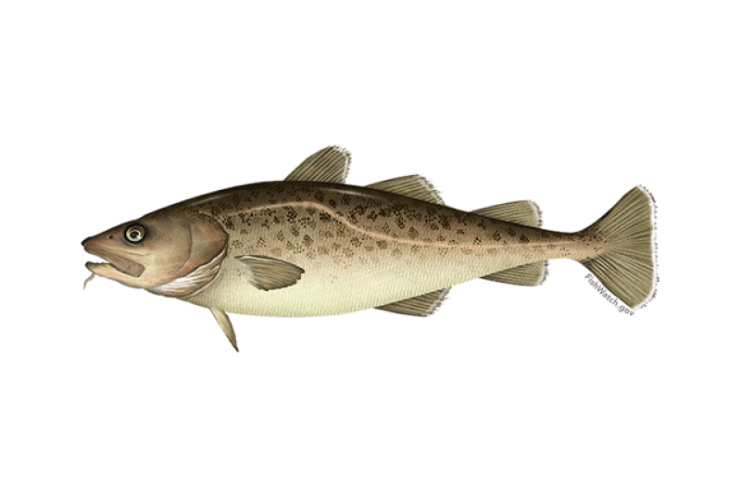
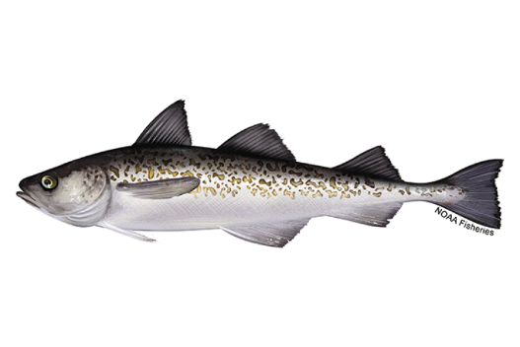

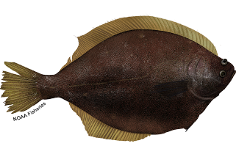
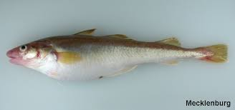
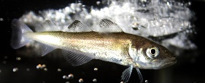
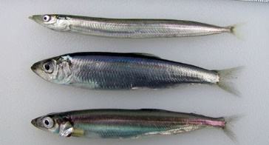
Non-focal relationship
Focal relationship
+
+
-
-
+
+
+
+
+
+
Notes:
Interpretation of above from abundance index results 4/6/23:
Consistent with conceptual model:
-arctic cod and saffron cod (on longer timescale) decreasing with less sea ice
-yellowfin sole, Pollock and Pcod increasing with less sea ice (and declining in last few years with increasing sea ice)
-herring increasing (in warmer years)
-bivalves increasing since 2010
Inconsistent with conceptual model:
-snow crab declining with presumably increased forage (perhaps confounded by temperature effects, disease, predation, cannibalism)

